Slide 1
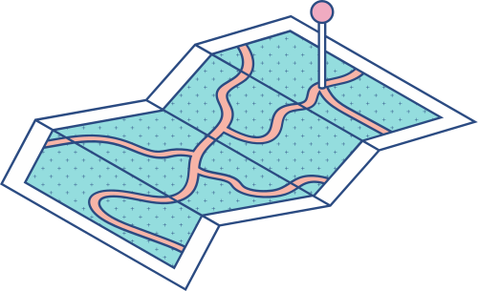





DEEP DIVE INTO CONTAINERS
Linux Namespaces: The Foundation of Isolation
A Comprehensive Guide to Containerization

Slide 2



Agenda
KEY TOPICS DISCUSSED IN THIS PRESENTATION
Overview of Namespaces System Calls: clone and unshare Kernel Interfaces and Implementation Details

Slide 3

Overview of Namespaces

Slide 4

Linux Namespaces
Linux namespaces constitute a fundamental mechanism
by which the Linux kernel enforces isolation at the operating
system level. At its core, a namespace partitions
global system resources into distinct views; as a result,
processes grouped within a particular namespace perceive
only a subset of the global resources, thereby ensuring isolation.
This architectural design underpins many modern
containerization technologies by allowing each container
to operate as if it were running on an independent instance
of the operating system.

Slide 5
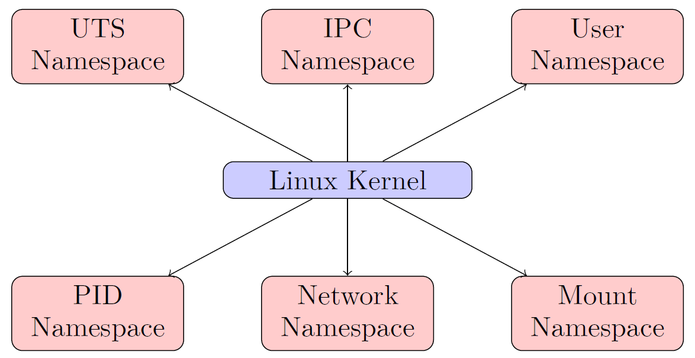
Linux Kernel
This diagram illustrates that the Linux kernel, acting as
the central point of control, administers multiple isolated
domains simultaneously. Each namespace is dedicated to
a specific resource domain, which collectively underpins
the isolation strategy.

Slide 6



Historical Context | Motivation
The rapid evolution of cloud computing and microservices architectures has driven the need for a lightweight form of isolation that offers many of the benefits of full virtualization but without the associated overhead. Early implementations of process isolation were limited either by complexity or by performance penalties. Linux namespaces emerged as a response to these limitations, allowing multiple containers to run on a single kernel instance while ensuring that each container operates in a separate and isolated environment. | The motivation behind namespaces is twofold. First, the isolation provided improves system security by preventing processes in different containers from unintentionally interacting or interfering with shared resources. Second, namespaces bolster resource efficiency by enabling multiple isolated execution environments to leverage the same underlying kernel. This model is now widely used in containerization tools like Docker and orchestration platforms such as Kubernetes.

Slide 7
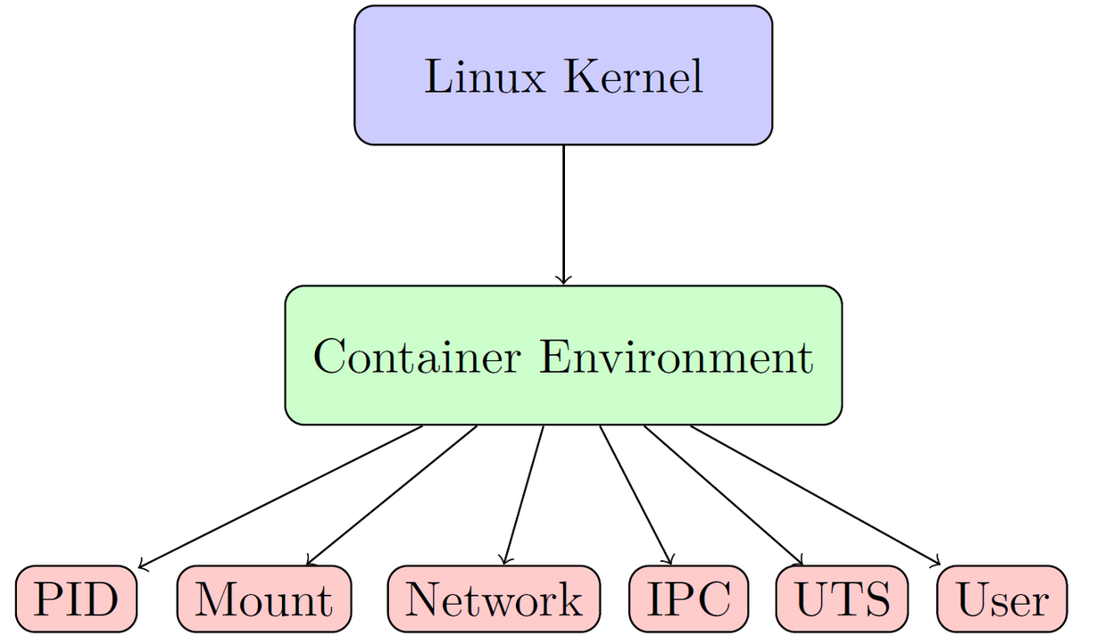
Namespace Architecture
This diagram emphasizes that the Linux kernel is the
source of all namespace functionalities, provisioning a container
environment into which various namespace types
are instantiated. Each namespace introduces a degree of
separation that collectively forms a robust isolation mechanism.

Slide 8
In summary, Linux namespaces embody a successful synergy between theoretical computer science—in the form of rigorous mathematical models and invariants—and practical software engineering, thereby underpinning the design and operation of contemporary container-based ecosystems. Continued research and innovation in this field promise to further refine and enhance the isolation mechanisms that are central to secure, scalable, and efficient computing.
Conclusion
Linux namespaces offer a mathematically rigorous and
empirically validated mechanism for achieving resource
isolation in containerized environments.

Slide 9
System Calls: clone and
unshare

Slide 10
Introduction
In traditional Unix-like operating systems, the fork system
call provides a simple yet powerful mechanism for
creating a new process. However, as system requirements
evolved to demand greater flexibility in resource isolation
and namespace management, the Linux kernel introduced
enhanced primitives such as clone and unshare.

Slide 11
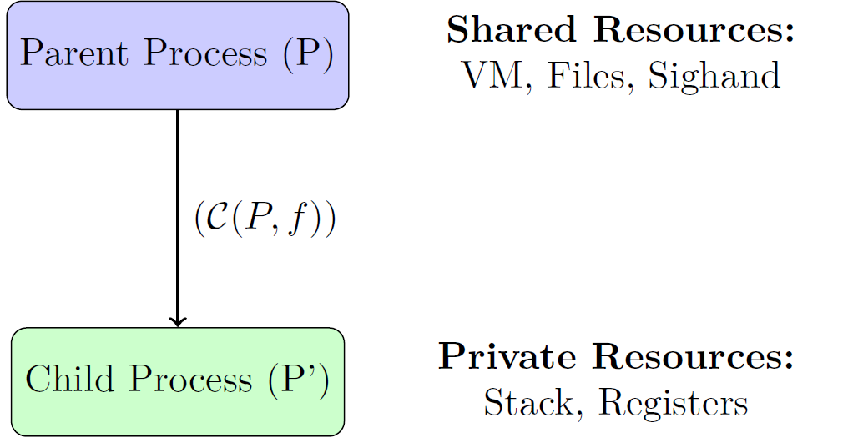
Process Hierarchy
In this depiction, the arrow from the parent to the
child represents the clone operation under the influence
of a flag function (f). The diagram emphasizes the dichotomy
between shared resources and those that are
allocated privately to the child.

Slide 12
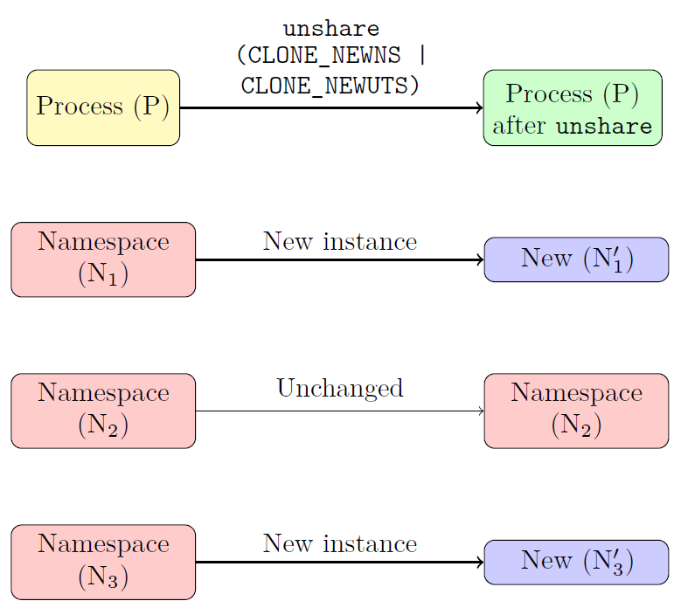
Isolating
Namespaces on Demand
In this diagram, process (P) initially belongs to the
namespaces N1, N2, and N3. After calling unshare with
flags indicating that N1 and N3 should be unshared, the
process is associated with new, isolated instances N′1 and
N′3, while N2 remains unchanged.

Slide 13
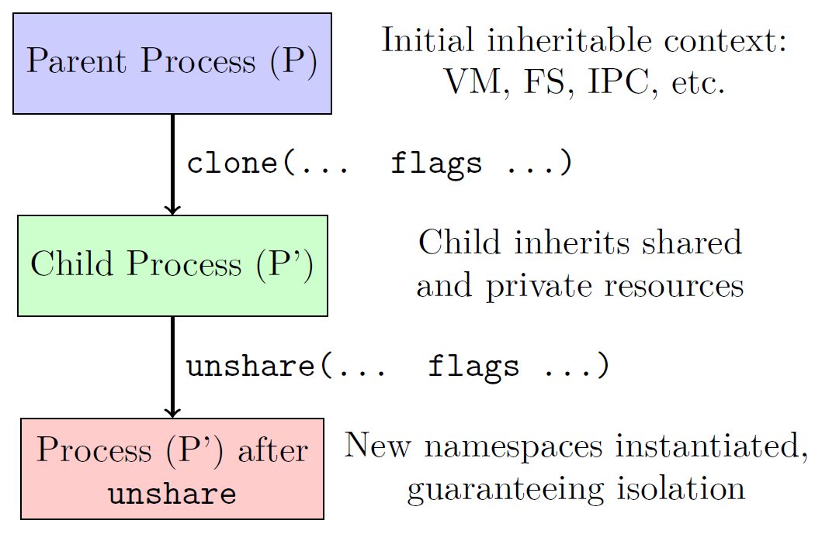
Combined clone and unshare Flow
This flow diagram demonstrates how a process can first
be created with a predefined context using clone and then
further adjust its environment via unshare to achieve a
high degree of isolation.

Slide 14
Kernel Interfaces and Implementation
Details

Slide 15
Overview of Kernel Interfaces
The Linux kernel organizes its interfaces into several major
categories. At the highest level, the system call interface
acts as the boundary between user space and kernel space.
This well-defined contract ensures that user applications
can request kernel services safely. In addition, the kernel
module interface allows developers to insert dynamically
loadable components into the kernel without the need for a
full system rebuild.

Slide 16
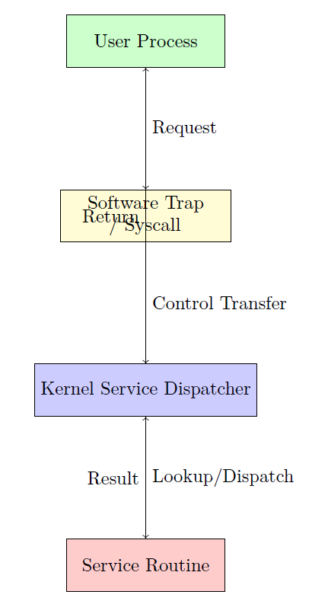
System Call Interface
This diagram illustrates the journey of a system call,
beginning with a user-level request that triggers a software
trap, entering the kernel’s service dispatcher, and finally
being handled by a dedicated kernel routine.

Slide 17
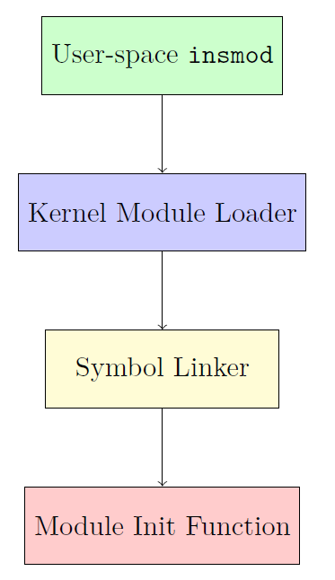
Kernel Module Interface
This workflow diagram encapsulates the dynamic process
of module insertion, from initiation in user space to the
execution of the module’s initialization routine within the
kernel environment.

